Slide 1

Hobby Web Application Project

Slide 2
Risk Assessment:
Risk |  | Severity |  |  | Response | Analysis
Risk | Effect | Likelihood | Impact | Possible Severity | Mitigation | Actual Severity | Evaluation
Loss of data | Some, if not all, work may be lost resulting in failure to produce the Minimum Viable Product. | 2 | 5 | 10 | Ensure work is continually saved and pushed to GitHub to maintain project repository. | 2 | Did not run into any data loss, however I did some work in the wrong branch, but this was fixed in the terminal.
Inadequate risk management | Project may be severely impacted if unforeseen risks occur and there is a lack of a planned resolution. | 4 | 4 | 16 | Ensure a comprehensive risk management strategy is developed in advance and possible risks are thoroughly assessed. | 5 | Most risks were assessed in advance, however some unidentified minor risks did occur.
Poor project planning | Deadline may not be met due to poor project organisation and unforeseen issues. Can lead to ineffective time management. | 2 | 4 | 8 | Complete risk assessment and thorough project plan prior to beginning project work. This reduces the likelihood of missing any deadlines. | 2 | Time could have been better planned but this did not affect my ability to meet the deadline or produce the Minimum Viable Product.
Failure to meet project criteria | If the required standard is not met this may demonstrate poor project completion or lead to failure. | 4 | 5 | 20 | Plan project according to the brief and be diligent to ensure the Minimum Viable Product is produced before making enhancements. | 1 | I have constructed my project according to the brief and have met each criteria, reducing the likelihood of the risk.
Inadequate testing coverage | Can cause exposure to bugs and other risks in the system that may remain undiscovered. | 2 | 5 | 10 | Ensure testing is comprehensive and high level of testing coverage is met prior to delivery. | 3 | I have reached a good testing coverage of 77.6% however this could be improved to avoid any bugs.
Overworking | Long working periods and inconsideration to health can lead to medical issues such as back pain and vision problems. Also risks poor continuation with project. | 4 | 4 | 16 | Health risks can be reduced by ensuring proper working environment and taking frequent breaks. | 8 | Due to the disturbances in learning over the last two weeks, this project required very long periods of work during the week. However, I made sure to take breaks.
GitHub server crash | Crashes to the GitHub system may cause inability to access and push work. | 1 | 3 | 4 | Continually save work and ensure project plan is followed to avoid failure to meet deadline. | 1 | No server crashes occurred while working on the application.
Unforeseen absence | Illness or real-life commitments may require absence and consequently impact ability to meet deadline. | 3 | 3 | 9 | Do not leave work until last minute, plan time ahead to avoid controllable absences. | 1 | No absences were needed during the week. I made sure to clear my schedule in advance.
Incorrect git push | Code may get overwritten or pushed to incorrect location. | 2 | 3 | 6 | Before pushing work, check the code that is being pushed and the location it is being pushed to. Code may be recovered with git restore function or through GitHub. | 1 | The risk was prevented by being careful in the terminal and double-checking before each git push.

Slide 3
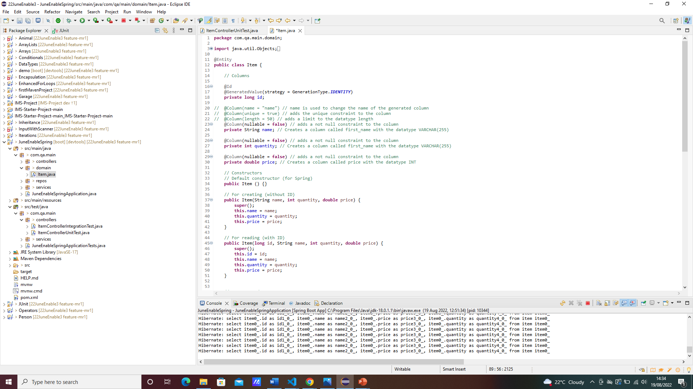
Backend:

Slide 4
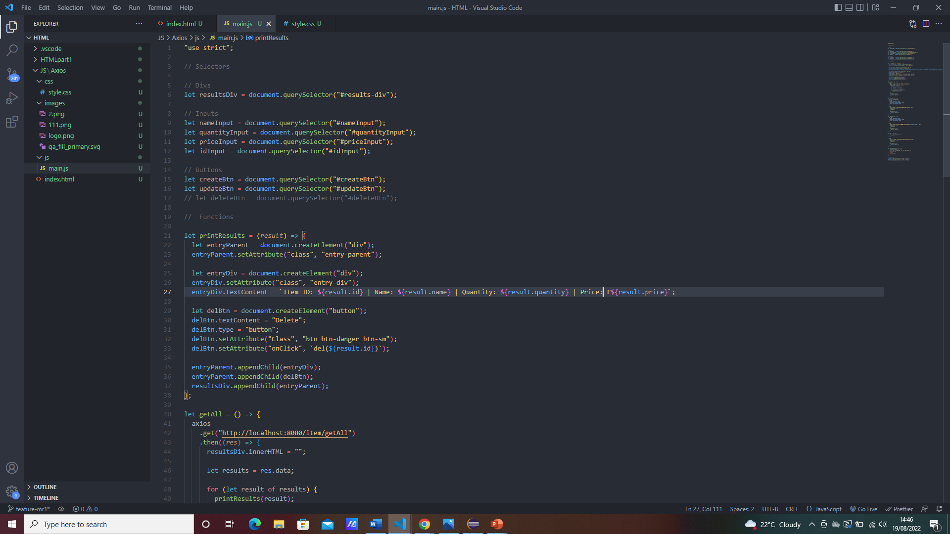
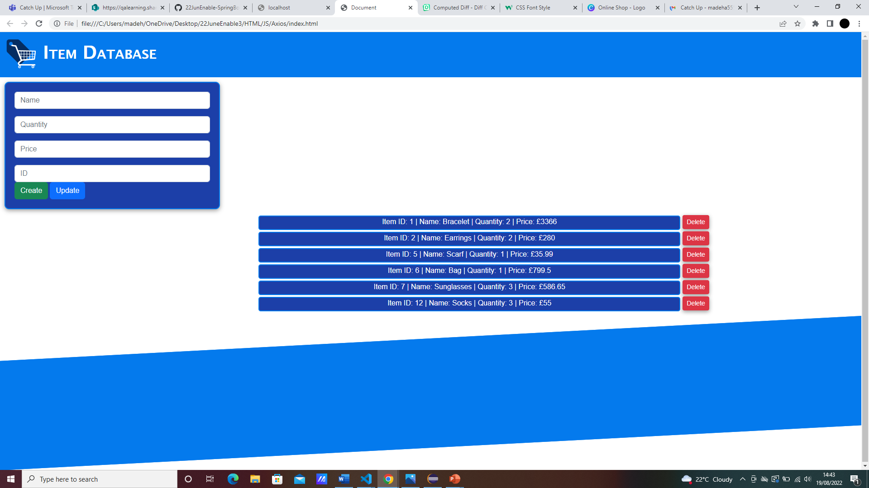
Frontend:

Slide 5
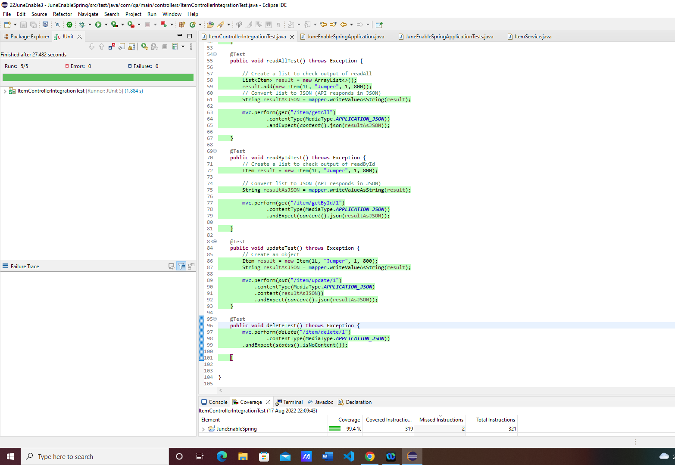
Integration Test
Coverage: 99.4%

Slide 6
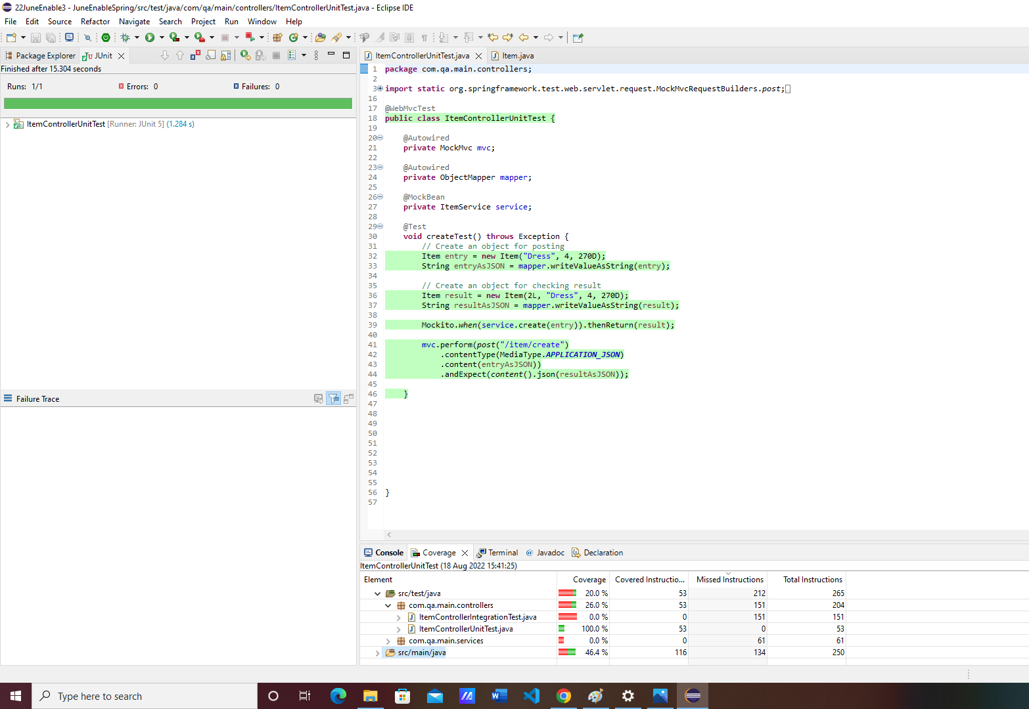
Item Controller Unit Test
Coverage: 100%

Slide 7
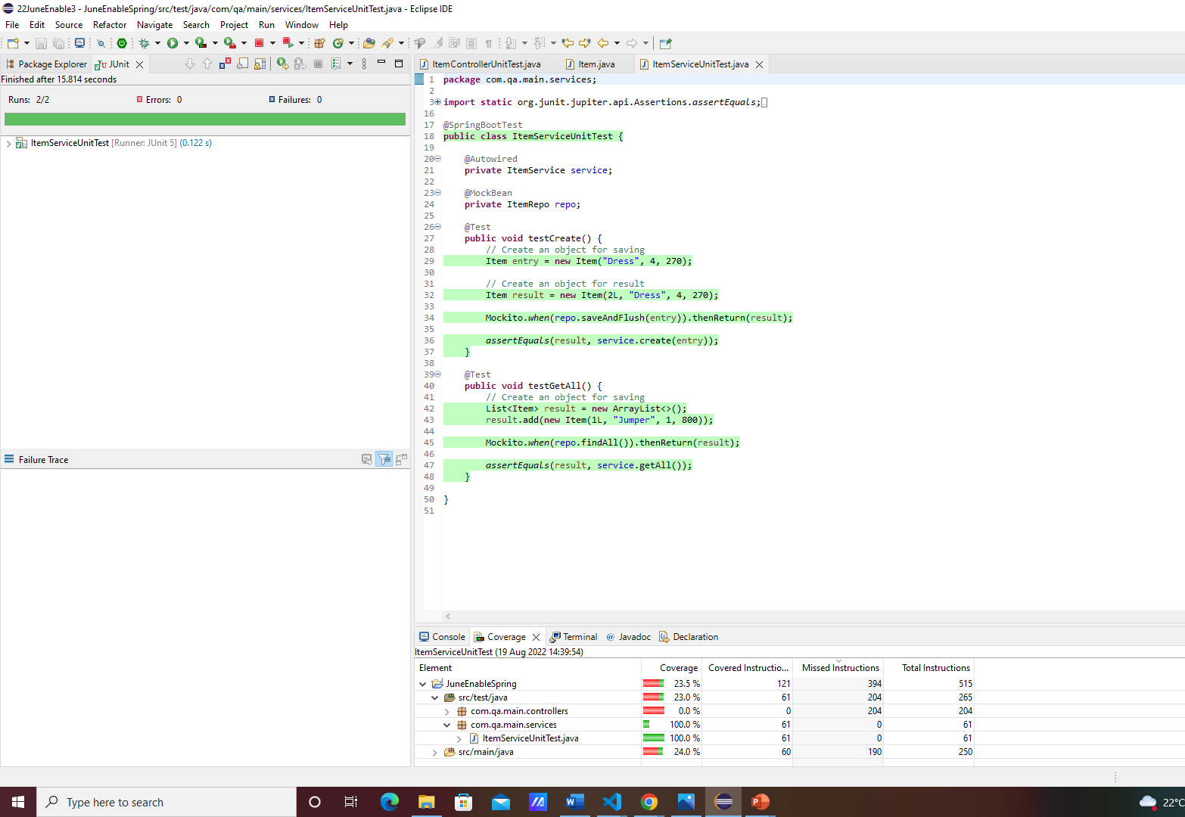
Item Service Unit Test
Coverage: 100%

